Slide 1
Daily Expense Manager Using MEAN Stack
RAJAT SINGHAL 14BCE094
SARATH KAUL 14BCE104

Slide 2
Core Features:
DashBoard
The dashboard would consist of all accounts created by user.
Total Balance
Latest Records
Navigation Toolbar to navigate to different Features.
A button to insert new Records.

Slide 3
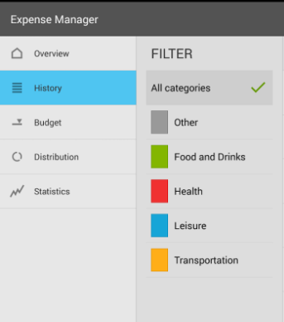
2. Navigation Bar
Monthly Report
Page to view all records(month wise)
Income expense Charts
Some other Features
3. User can insert future Payment
4. Debts can be inserted
5. Individual account can be maintained separately

Slide 4
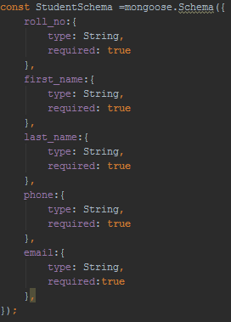
Use of MongoDB
We would be using MongoDB as our database to store all the records and user related information like login info, accounts created by user etc.

Slide 5
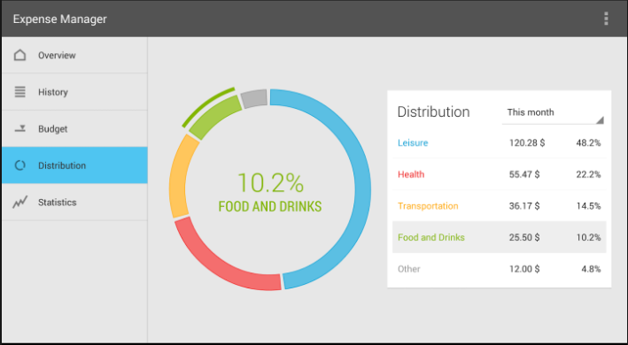
Use of angularJs
The whole UI would be designed using the AngularJS. We have seen some wallet applications and we would be designing the UI as simple as possible so user can easily use the UI.

Slide 6
Use of NODEJS
NodeJS would be user for the backend connectivity between the UI and MongoDB. It would fetch records from the database and same would be reflected into the UI.

Slide 7
Implementation
Login/SignUp Page
We have first implemented the login/ signup page to keep track of the users which are using our web-app.
We have used different modules like login and register to implement the same.
We have defined authenticate service to authenticate the user at the time of login and if any wrong info is provided than appropriate flash messages are generated.

Slide 8
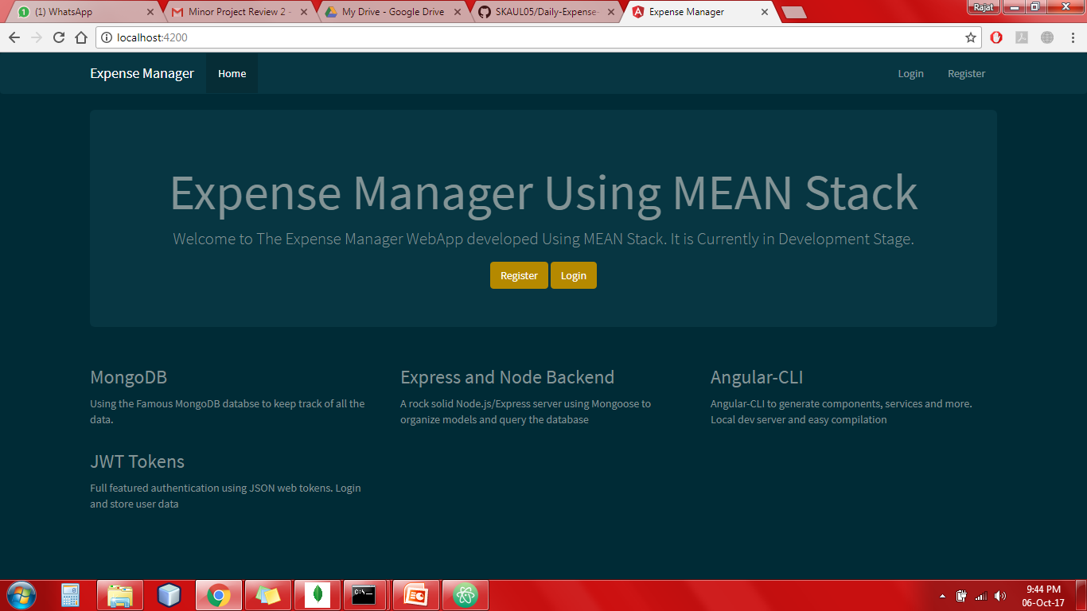
HomePage

Slide 9
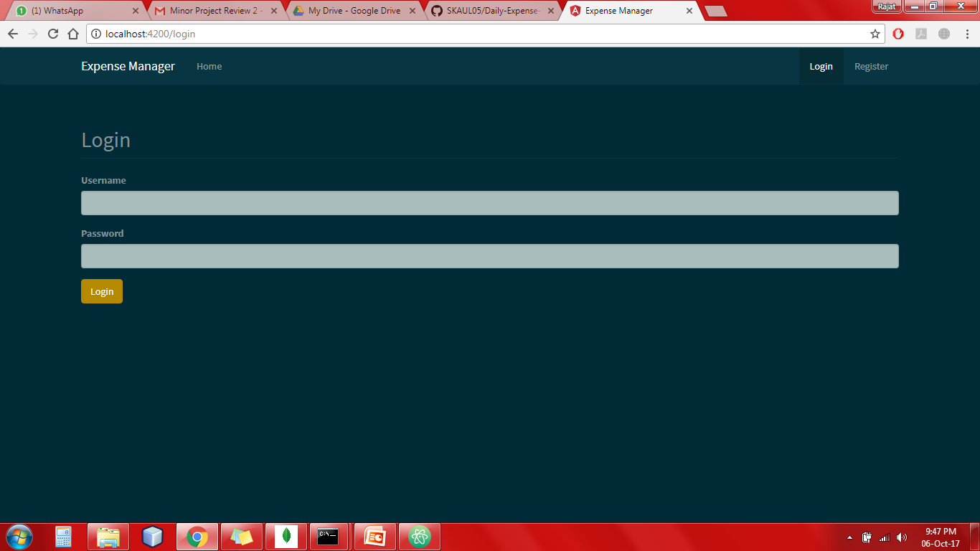
Login Page

Slide 10
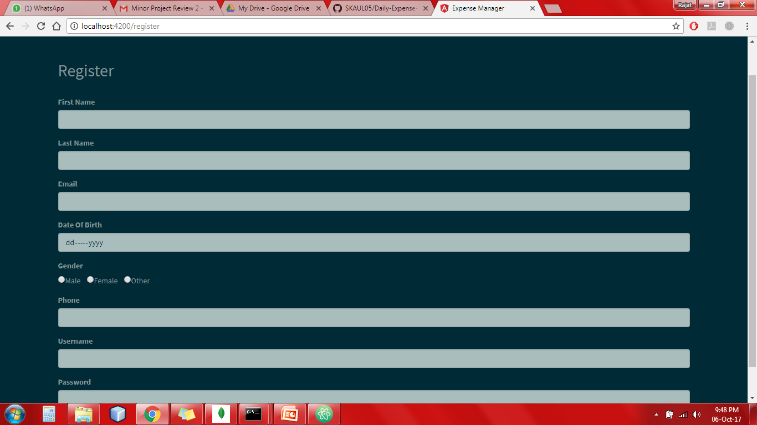
Sign-Up Page

Slide 11
Implementation
After successfully logging-in the account user is moved to dashboard where there are several option which are available to the user.
Profile: where all the personal details of user is displayed.
Transactions: To add transactions to particular account here user can add, modify and delete the transaction.

Slide 12
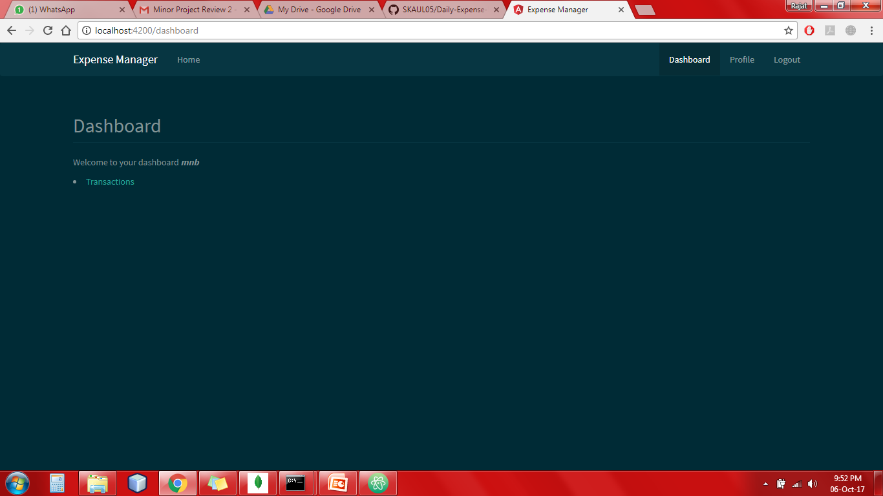
Dashboard

Slide 13
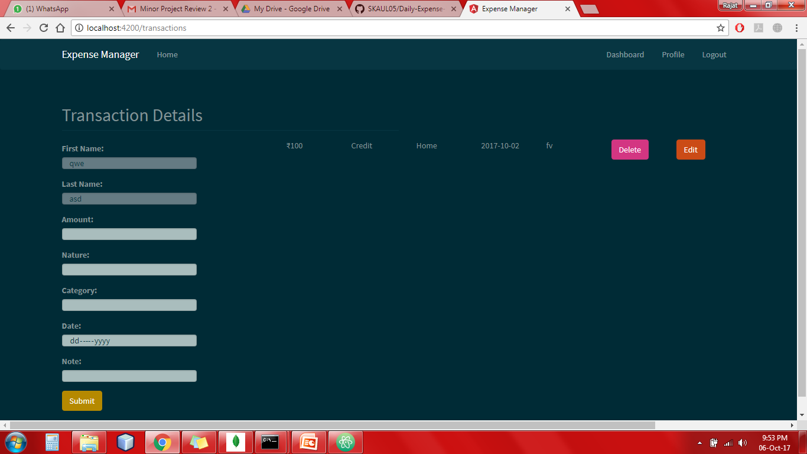
Transactions

Slide 14
Database Creation
We have generated our database using mongodb.
There is an unique e-mail Id for every customer which distinguish a user from other users.
Corresponding to a user different fields regarding personal information is added.
Apart from personal information there is transactions associated to every customer which is fetched using the e-mail id which is unique.

Slide 15
Database Creation
We have kept the username fixed while adding a new transaction as t would not be changing.
The username is prefetched in the fields and cannot be modified.
After adding a transaction we can modify it all the fields will be prefetched and we can do the desired modification.

